Slide 1

Kotlin Programming Language Brian Ortiz, Lee Wilson, Eamon Jouett, Max Simmer

Slide 2
Background

Slide 3


Introduction to Kotlin
Developed by JetBrains
First official release: 2016
Open source
Growing fast
"Better Java"
Java interoperability
More concise
Null pointer safety
Immutability
Faster
Lambdas with recievers
Android Studio Support, mobile apps, web back end
Borrows from Scala
Notes:
Sample spoken presentation, timed at 1:29- Kotlin is developed by JetBrains of IntelliJ fame. Work on the language began in the early 2010s and the first official version released in 2016, so it's quite new compared to many of the other programming languages we know. Kotlin is open source. Its popularity is growing quickly. The main rationale behind kotlin development was to create a better java. There's several ways Kotlin attempts to improve java, I'm going to skim over them and some will be elaborated on later. Kotlin is interoperable with java, meaning it was designed so that it is easy to call java code from Kotlin programs and kotlin code from java programs. JetBrains claims it is on average 40% more concise than java in terms of lines of code written. Kotlin had null pointer safety and encourages immutable structures with var and val keywords. Kotlin is faster than java and supports lambdas with recievers. Kotlin is, of course, usable in many ways but is primarily popular with mobile developers and web back end developers. If any of you took comp 313 like me or you have android studio experience, you know that Java is the primarily supported language. However kotlin support has been added as well. Kotlin also borrows heavily from Scala, which came a bit before it, so when you see the code samples it should look very familiar to all of you.

Slide 4
Code Sample

Slide 5
Kotlin sample code
Remove Duplicates
The code begins by importing the Scanner class from the java.util package, which is essential for reading user input from the console.
Covert input to Array - The input string is split into individual components using the split(" ") method, which creates a list of strings. Each string is then converted to an integer using map { it.toInt() }, and finally, it is transformed into an array with toTypedArray().
Remove duplicates using a Set (which inherently does not allow duplicate values)
Then covert back to an Array using toTypedArray()
Kotlin is 100% interoperable with Java
With this perk, you can easily use either Kotlin or Java libraries when working on Kotlin data projects.

Slide 6
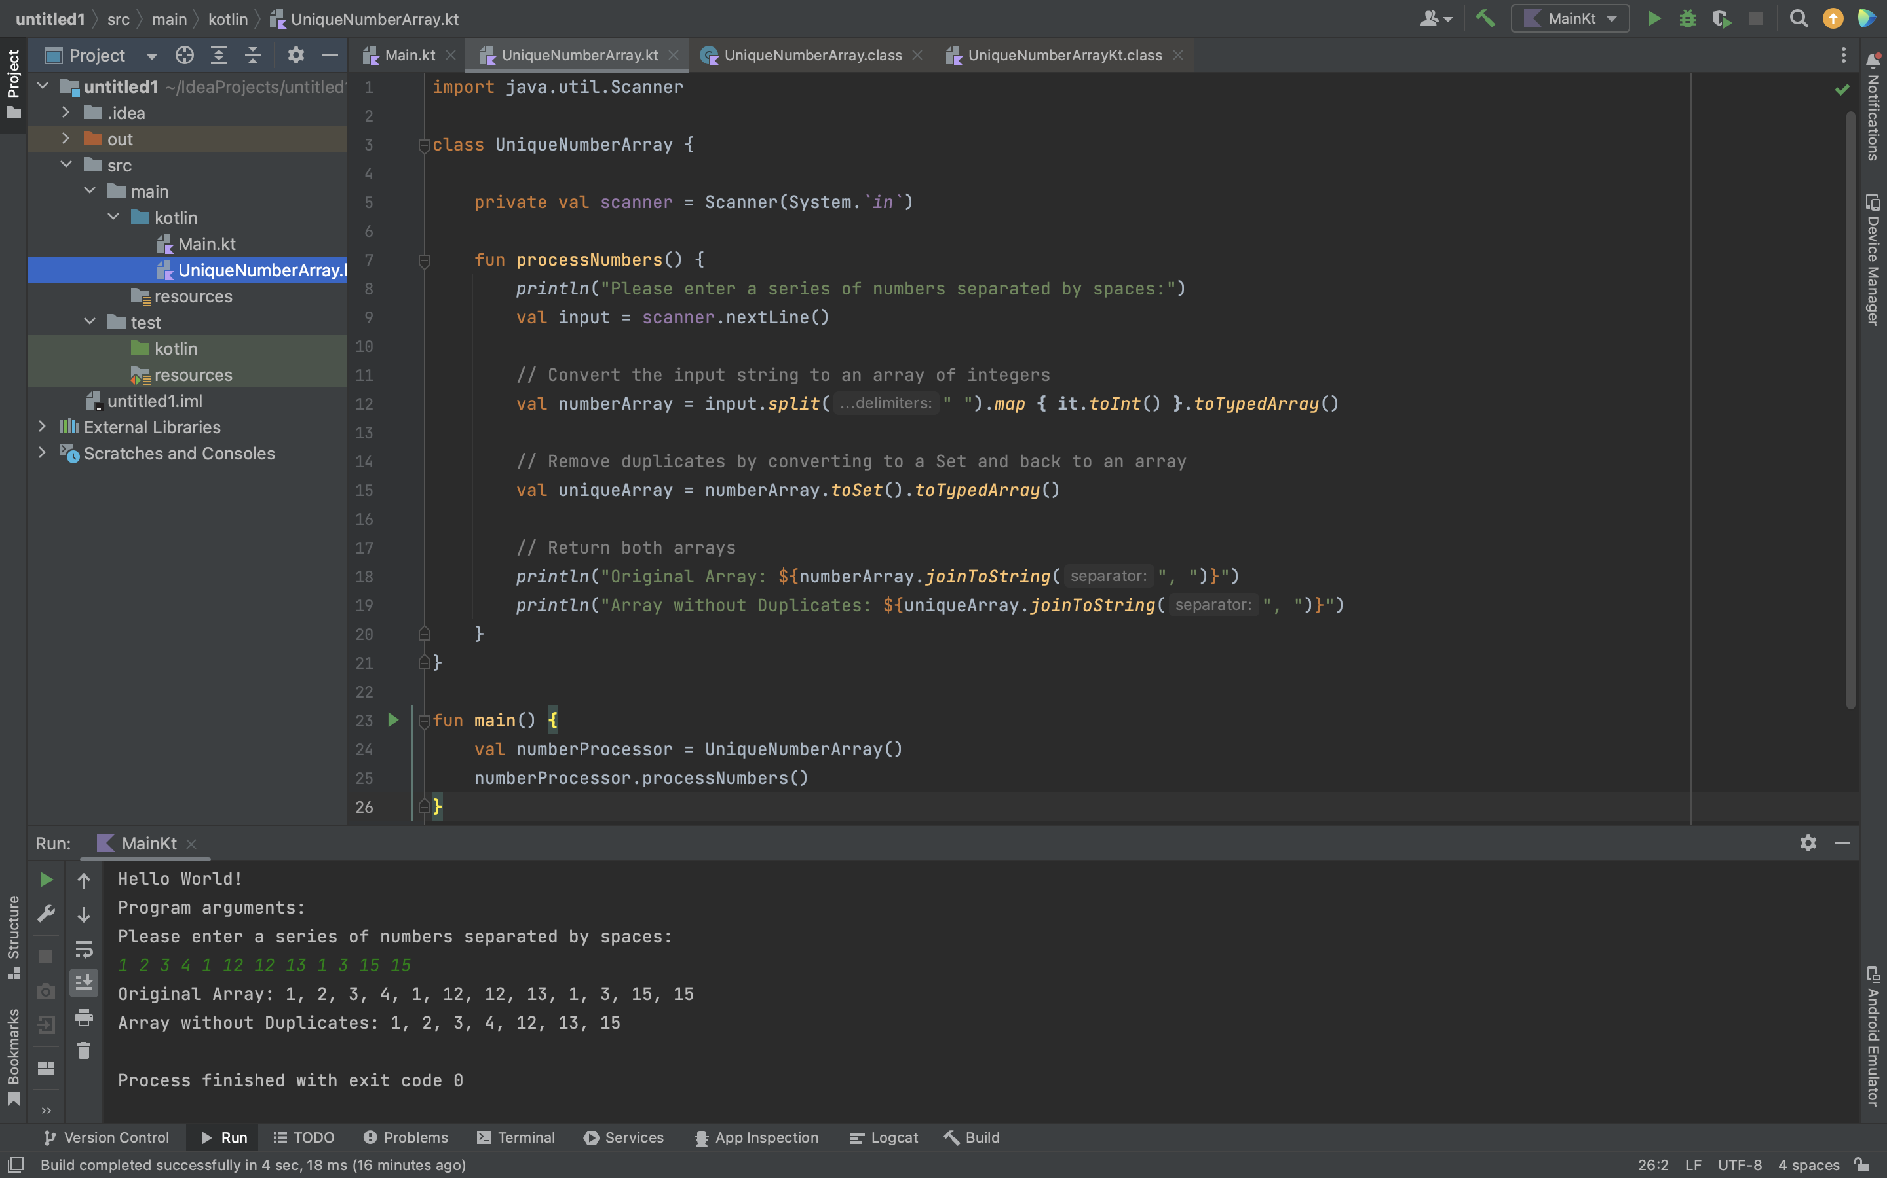

Slide 7
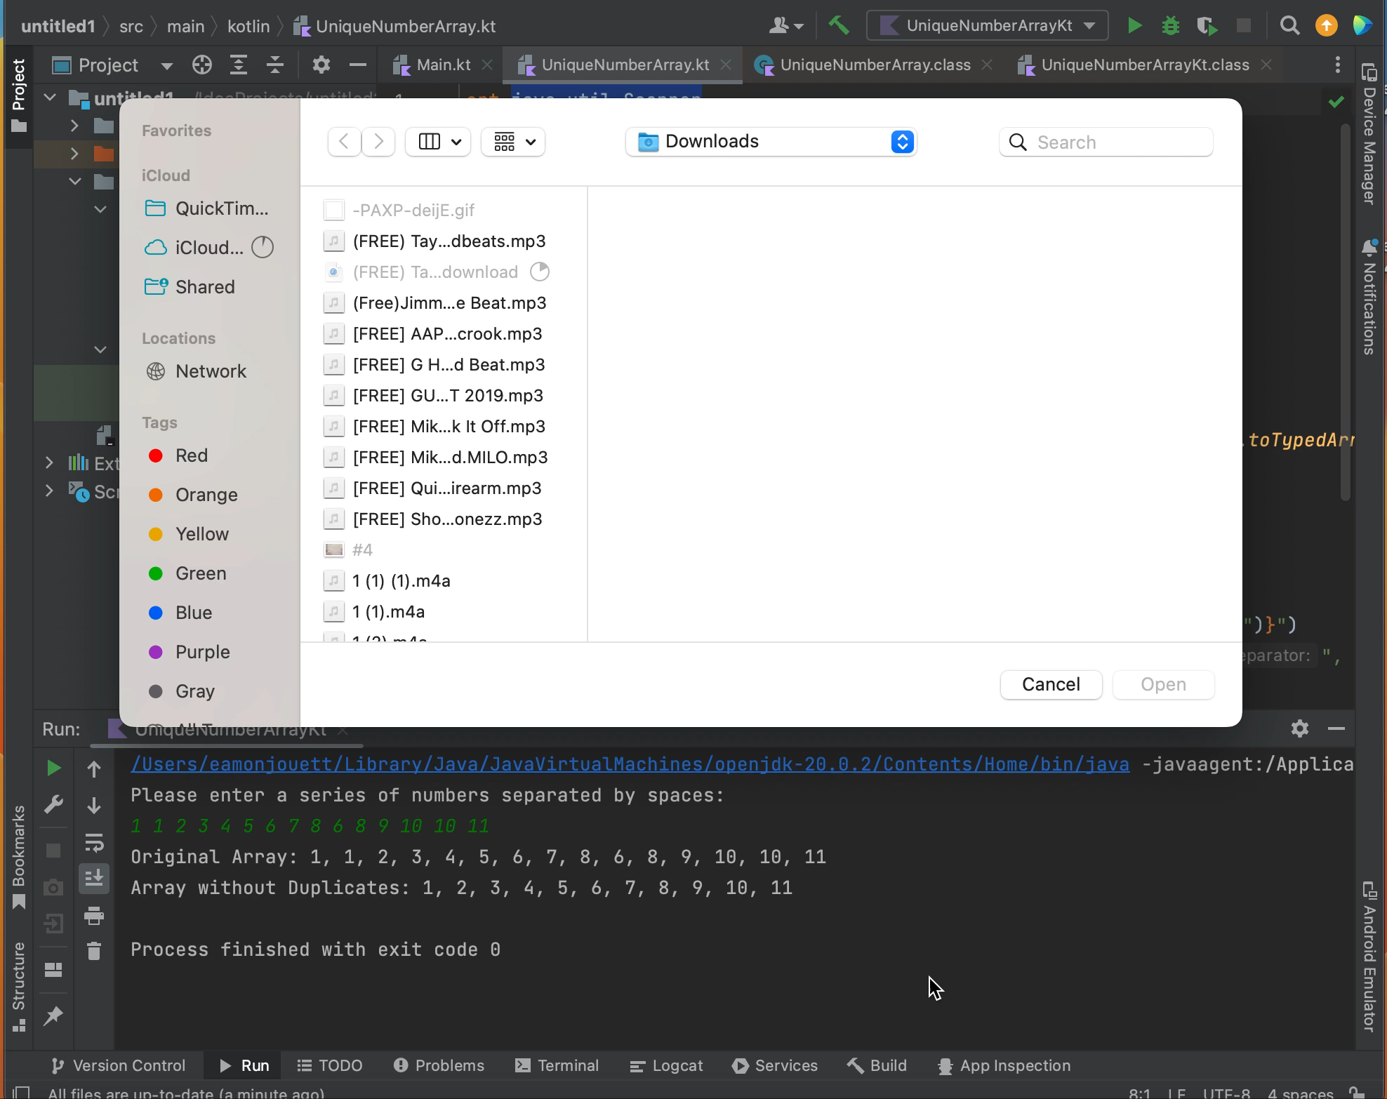

Slide 8
Classification

Slide 9
Classification
Paradigms
Compatability
Open-source and statically typed
Kotlin supports a few different paradigms, with the main ones being object-oriented programming, functional programming.
Classes, objects, and inheritance are all allowed etc.
The usage of higher order functions and lambda expressions allows the code to be more concise.
Code written in Kotlin is organized into procedures and functions.
Kotlin was built to run on the JVM, allowing the usage of Java libraries but this also allows it so Kotlin can call on Java code.
Kotlin can also be compiled into JavaScript making it ideal for web development on IOS and Windows.

Slide 10
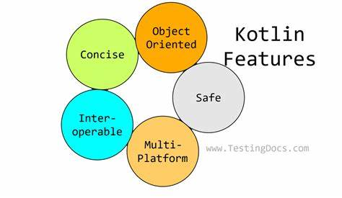
Principles
Kotlin aims to reduce the amount of boilerplate code that developers need to originally write.
Safety is considered by implementing the elimination of null pointer exceptions and immutability.
Java and Kotlin being interoperable.
The goal is to make code easier to read, write, and maintain with the usage of OOP and FP paradigms and principles.

Slide 11
Evaluation

Slide 12
Evaluation
Criteria
Other Consideration:
Readability
Kotlin depends on the Java Class Library (100% Compatible with Java)
Type inference allows for concise syntax
Relaxes Java syntax
Borrowed significantly from Scala (i.e. optional semicolons, variable declaration/data type placement, public by default classes, etc.)
Writability/Productivity
One of the stated goals of Kotlin developers was to compile as quickly as Java
Statically typed
Concise syntax means less code to produce same results
Reliability
Produces Jave 8 bytecode by default, but lets engineer choose from 8-20
Null-Pointer safety (guarantees no object references will have null or void values)
100% compatibility allows for easy migration from Java to Kotlin
Cost
Developed and supported by JetBrains
Community, books, industry backing, etc.
Fastest growing language on GitHub in 2018
Major projects (e.g., C used for Unix and lots of other stuff)
In May 2019 Google Announced that Kotlin was now its preferred language for Android app developers
Google has about 60 apps written in Kotlin (i.e. Maps and Drive)
Ecosystem (availability of tools and libraries for the language or the platform it represents)
Android Studio
Emacs
IntelliJ IDEA
Gradle
Cons
Relatively new compared to Java, less learning opportunities
Fewer Kotlin experts vs Java experts

Slide 13
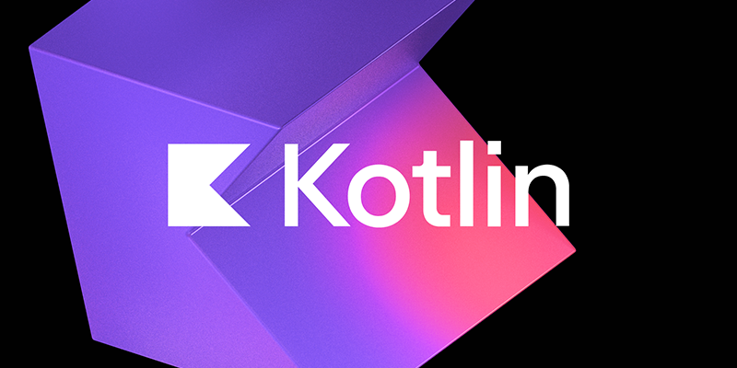


Learning Resources
Android Developer
https://developer.android.com/courses
Kotlin Language Org
https://kotlinlang.org/docs/books.html
Jet Brains Academy
https://blog.jetbrains.com/education/2024/04/04/kotlin-learning-guide/

Slide 14
Conclusion
Key Takeaways
Kotlin is a fast growing "concise Java"
Open source, funded by JetBrains
100% interoperable with Java
Supports most programing paradigms
Google's programming language of choice for Android applications
Relatively new compared with Java, learning opportunities exist but are less common

Slide 15
Questions?

